Slide 1

Elastic Kubernetes Service (EKS)
Done By: Shiny Fedora A

Slide 2
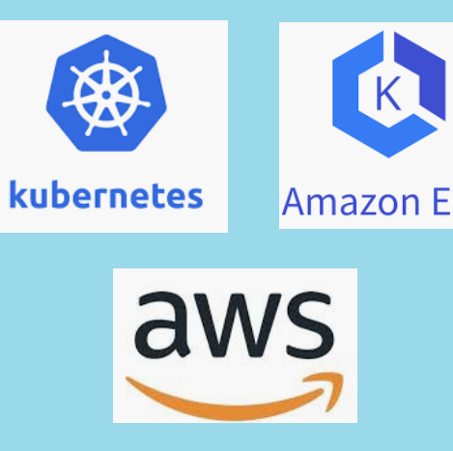
What is EKS?
EKS simplifies the deployment and management of Kubernetes clusters by providing a managed control plane, which is responsible for orchestrating the cluster's resources and ensuring its stability.
This eliminates the need for manual provisioning and configuration, allowing you to focus on deploying and scaling your applications.

Slide 3
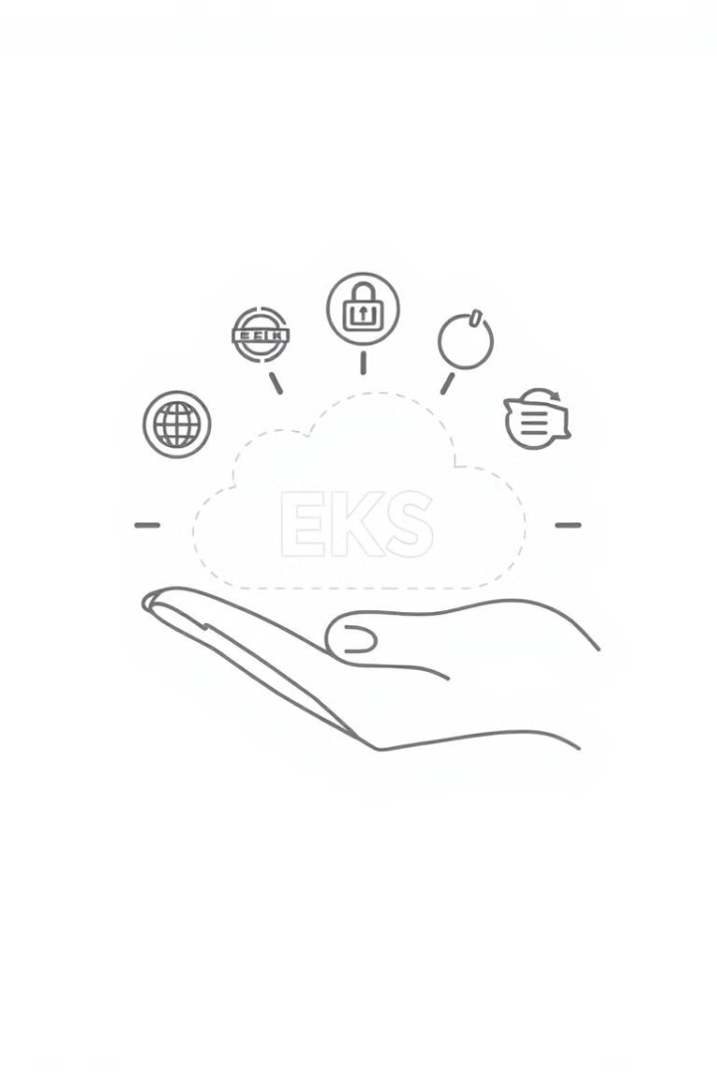
Benefits of EKS
Scalability
EKS enables you to scale your applications seamlessly, both horizontally and vertically.
Security
EKS provides robust security features, including network security, identity and access management, and compliance certifications.
Cost-Efficiency
EKS is cost-effective due to its pay-as-you-go pricing model and ability to optimize resource utilization.
Ease of Use
EKS is designed to be easy to use, with intuitive tools and documentation to simplify deployment and management.

Slide 4
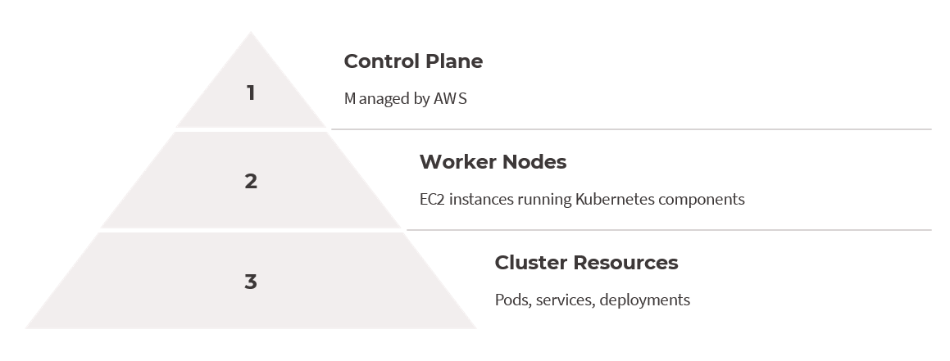
EKS Architecture

Slide 5



Deploying Applications on EKS
Containerization
Kubernetes Deployment
EKS Integration
Package your application code into Docker containers.
Deploy your containers using Kubernetes YAML files.
Deploy your application to the EKS cluster.

Slide 6
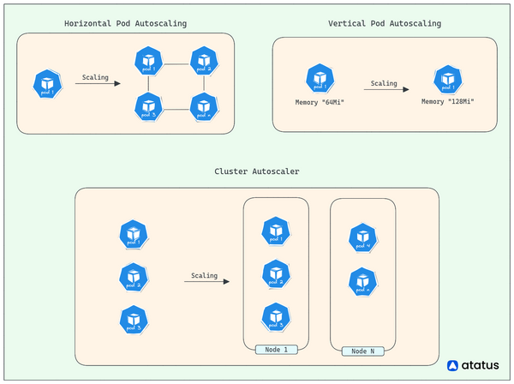
Scaling and Autoscaling with EKS
Horizontal Scaling
Add or remove worker nodes.
Vertical Scaling
Adjust resources allocated to individual pods.
Autoscaling
Automatically scale resources based on metrics.

Slide 7

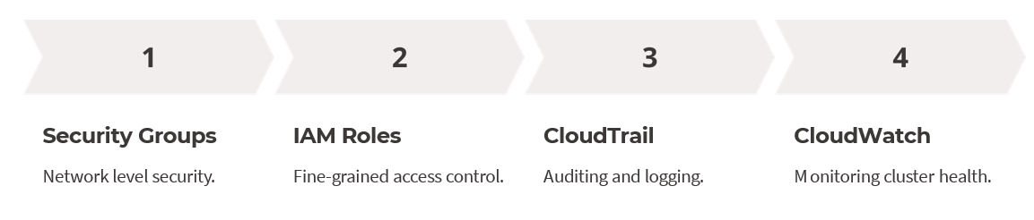
EKS Security and Monitoring

Slide 8

Thank You

